Slide 1
Bruno de Finetti Lecture – 2022 ISBA World Meeting
Subjectivist Model Uncertainty Analysis
for Prediction and Decisions
Mike West
Duke University
June 28, 2022 : Montreal

Slide 2
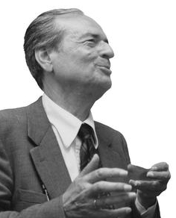
Bruno de Finetti 1906–1985
“From the subjective standpoint, no assertion is possible without a priori opinion, but the variety of possible opinions makes problems depending on different opinions interesting.”
2nd Berkeley Symposium, 1951
[ & requoting Cifarelli and Regazzini, Statistical Science 1996 ]

Slide 3

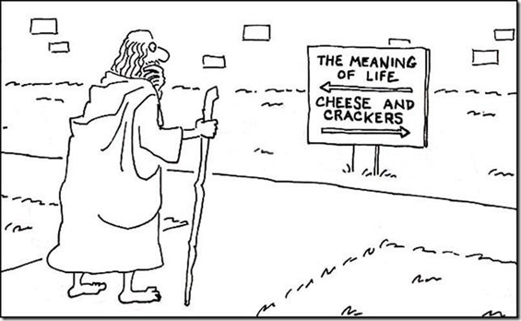
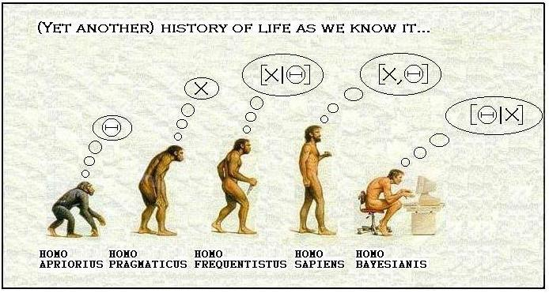
The Yin & Yang of subjective Bayesian analysis
Belief analysis
Modelling, inference, prediction
Decision analysis
Preferences, utilities, actions
[ M. Goldstein, discussing D.V. Lindley, Valencia IV, 1992 ]

Slide 4
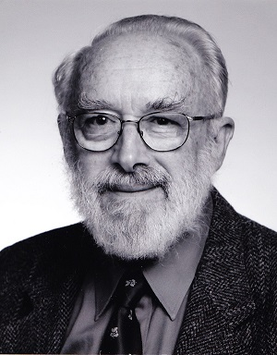
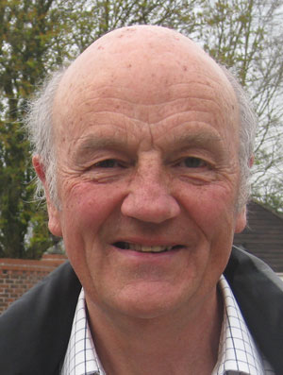
Two subjective belief & decision analysts
Dennis V Lindley
1923 – 2013
P Jeff Harrison
1935 – 2013
Models “discipline” prediction & decisions
“(modelling, systems) relevant to subsequent decisions based on forecasts”
J. OR Society 1971
Making Decisions 1971
Bayesian Statistics IV 1992
“Is our view of Bayesian statistics too narrow?”

Slide 5


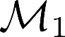
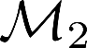
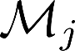
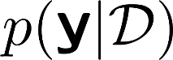
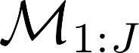
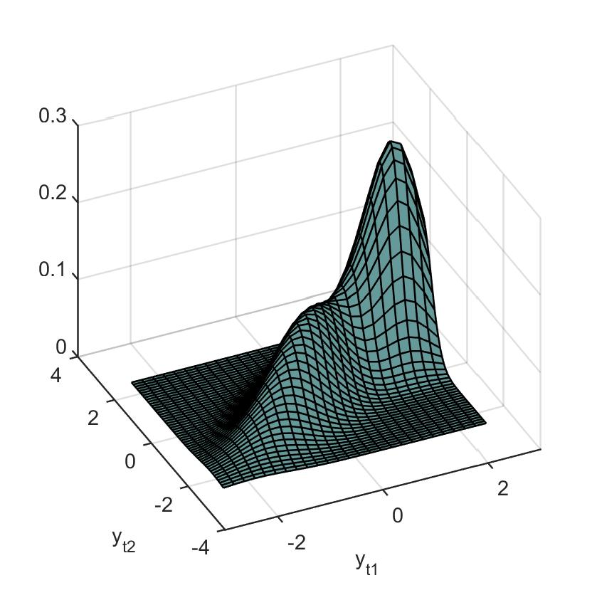
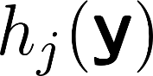
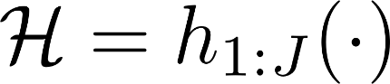
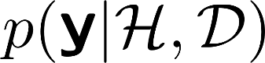
Multiple “opinions” or “models”: Predictive synthesis
Predict vector outcome f
…
…
Past data, information f
Prior f
Model set:
Predictions
“Information”
Predictive synthesis: f

Slide 6
Formalisms: Some history, some questions
Bayesian model averaging
Linear pooling: Mixtures
“Stacking” methods
…
Model-specific calibration, biases, …
Incomplete model set
Domains of expertise: Multivariate
Model inter-dependencies
Predictive & decision goals
Bayesian? Foundations / theory?
Macro-economics/Central bank forecasting:
[ Hall & Mitchell ‘07; Geweke & Amisano ‘11 ; Bjørnland et al ‘11;
Billio et al ‘13 ; Fawcett et al ‘13; Aastveit et al ‘14; Kapetanios et al ‘15; Amisano & Geweke ’17 ..… ]

Slide 7

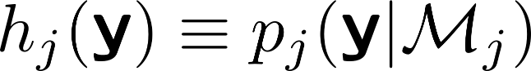

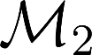
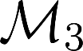

Bayesian predictive synthesis (BPS) - Foundations
Where do model predictions come from?
- From one of my models
….

Slide 8

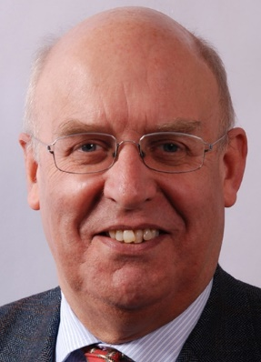
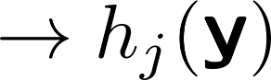
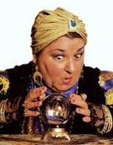
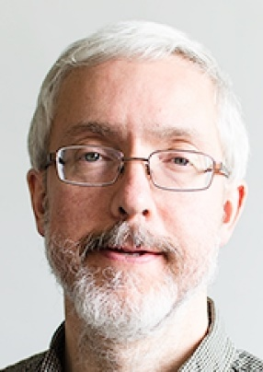

Bayesian predictive synthesis (BPS) - Foundations
j=2
j=1
Where do model predictions come from?
- From J external models, systems, forecasters (“experts” or “agents”)
j=3
40+ year literature: “agent opinion” …
… with some foundations & theory
economics, meteorology, reliability, management science, etc
….
j=4
j=J
[ D.V. Lindley, 1980/90s; Crosse & MW ‘92, MW ‘84, ‘92 ]

Slide 9
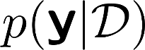
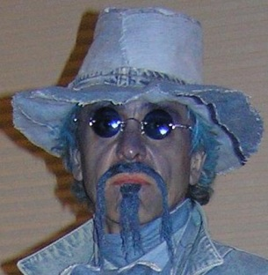
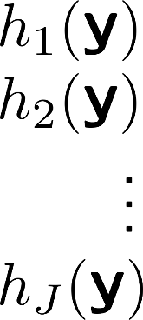

Bayesian predictive synthesis (BPS): Supra-Bayesian
?
Prior:
New “data”:
Subset of possible posteriors:
p.d.f.
Implicit latent factors
[ Lindley, early-mid 1980s; Genest & Schervish ‘85; Crosse & MW ‘92; MW ‘91,’92 ]

Slide 10
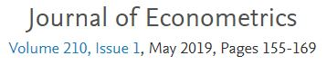
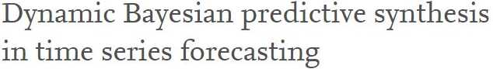
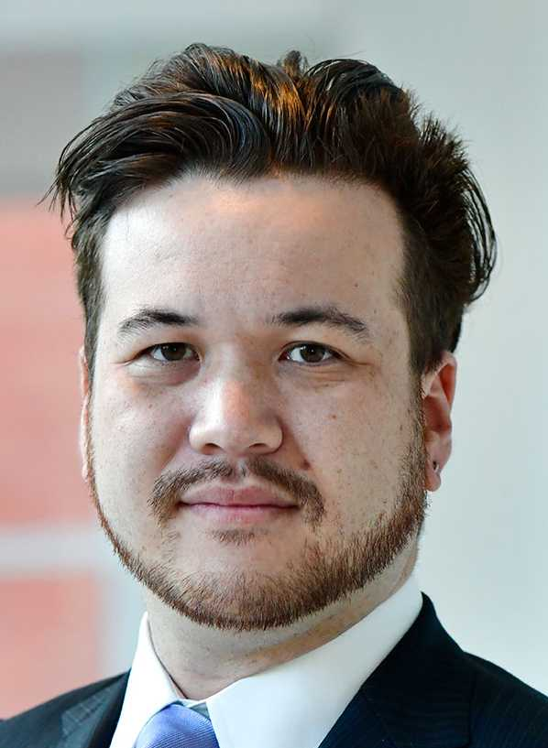
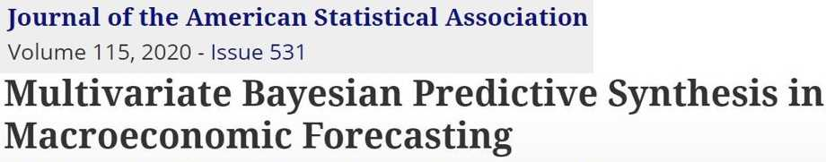
BPS examples (1): Time series forecasting
McAlinn & West 2019
History
Foundations
Applications
McAlinn, Aastveit, Nakajima & West 2020
Ken McAlinn
- Many predictor variables
- Mixed frequency forecasting
- New theoretical properties
+ …
& other groups in applications in macro-econ, central banks, …

Slide 11
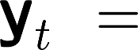
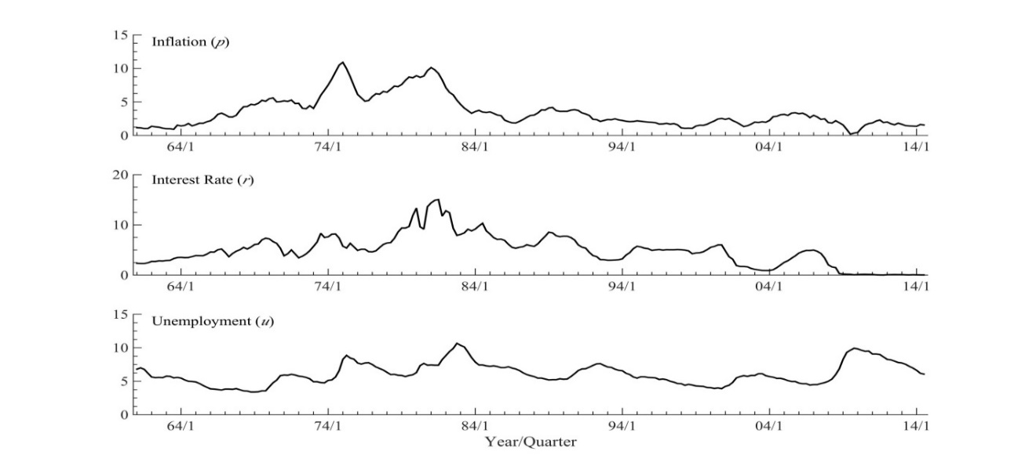
Dynamic BPS: Multivariate forecasting
inflation
wage growth
unemployment
consumption
investment
short-term interest rate
Parametric dynamic factor model
Time-varying parameters:
regression “weights” on models
model-specific biases, calibration
dependencies across models
intercepts & volatilities
model set incompleteness
Inflation
Interest rate
Challenging
Dynamics
Multiple models
Unemployment

Slide 12
Forecast goals in model comparison and combination
e.g., k=12 or 24-months ahead
Key foci, potential for improved accuracy
Synthesise k-step forecast distributions
- Forecasting goal defines BPS modelling perspective-

Slide 13
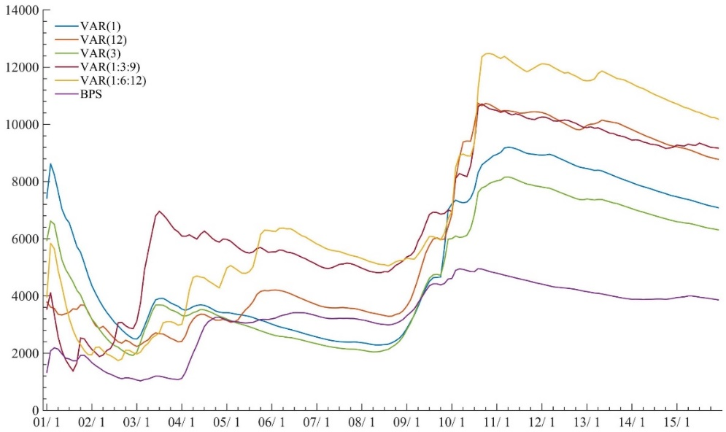
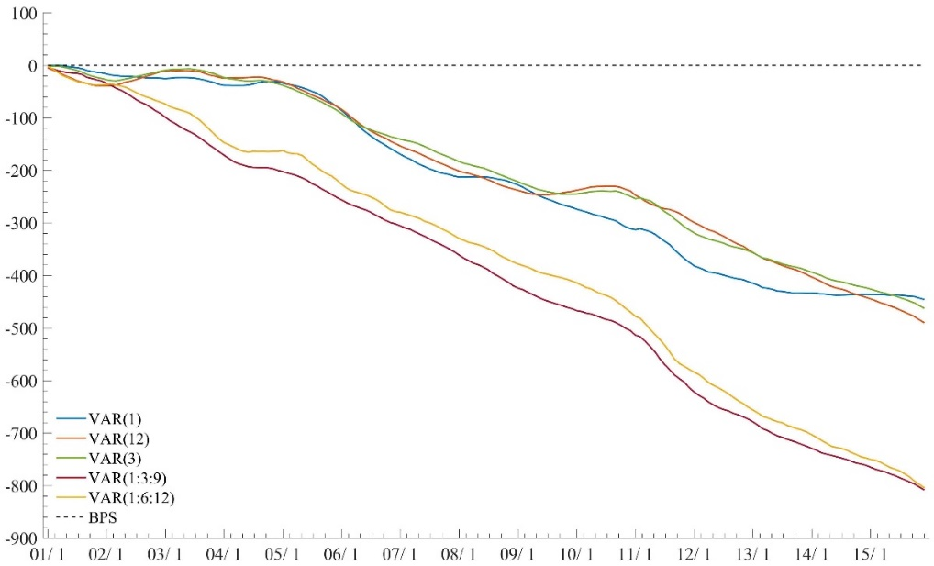
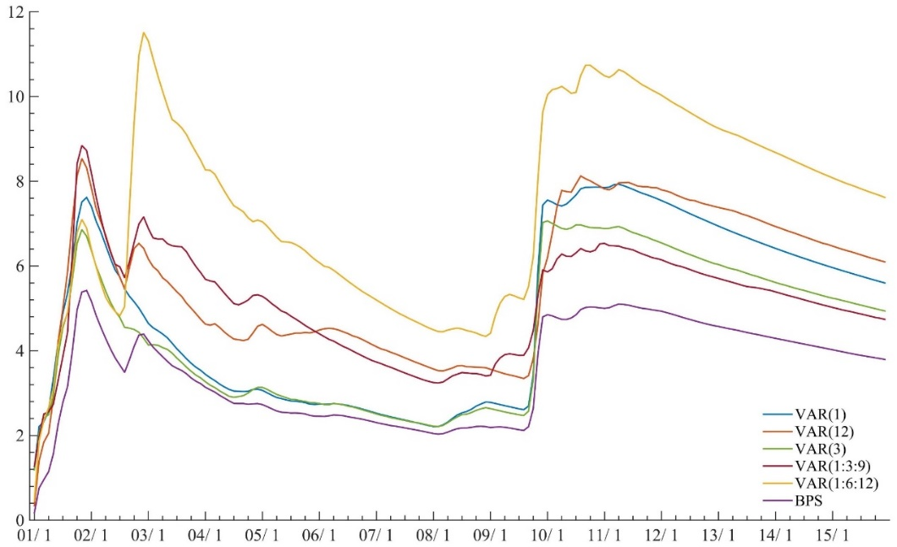
Multi-step ahead US macroeconomic forecasting
MSFE Investment
BPS (24months) log pdf score
MSFE Interest rate

Slide 14
Key (today) BPS examples (2): Mixtures/pooling
Weights to:
choose?
estimate?
optimise?
BMA?
…
BPS requires a j=0:
baseline
addresses model set incompleteness
“Best” weights?
Forecast accuracy – forecasting what?
Decisions? Utilities?
Update with new data – how?
[ Hall & Mitchell ‘07; Geweke & Amisano ‘11; Bjørnland et al ‘11;
Billio et al ‘13; Fawcett et al ‘13; and many more … ]

Slide 15
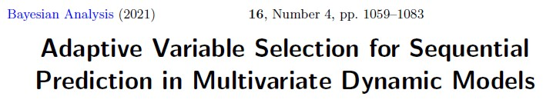
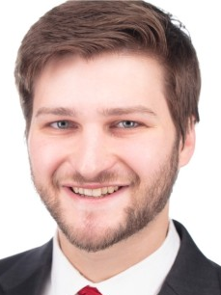
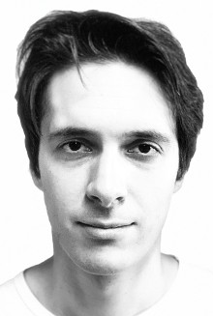
BPS and goal-oriented forecasting: An example setting
_
_
_
AVS
c.f. “generalized Bayesian updating”
- Bissiri, Holmes & Walker ’16
& “focused prediction”
- Loaiza-Maya, Martin & Frazier ’21
Isaac Lavine
Michael Lindon
[ Clyde & Iversen ’13; Geweke & Amisano ’11, ’17; Nakajima & West, ’13; and more … ]

Slide 16
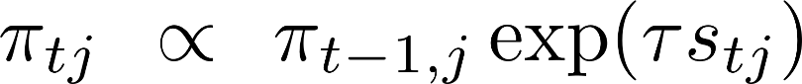
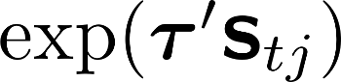
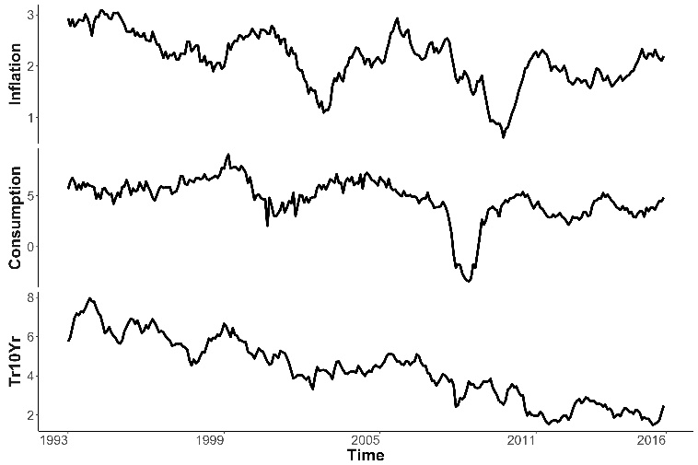
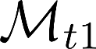
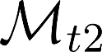
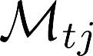
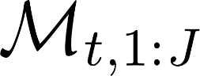
BPS goal-oriented mixtures: Examples in time series
Scoring past/recent forecast outcomes on chosen metric(s)
Multivariate dynamic models
Current and/or lagged predictors?
…
…
Inflation
Consumption
10-year T-bill
Wage Growth
M2 Money
BAA Corp Bond
Gold
…
Model set:

Slide 17
Macroeconomic forecasting: Goals?
? k=12 or 24-months ahead
? k=1:24-months ahead jointly: “path” forecasting
BMA ? 1-month ahead score
Model for forecast &/or decision purposes
- Assess, compare, combine models modulo goals -

Slide 18
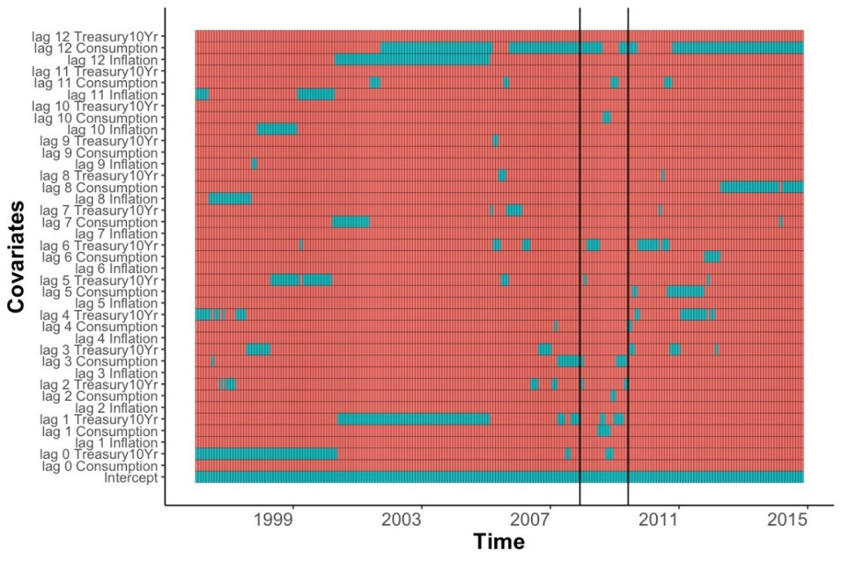
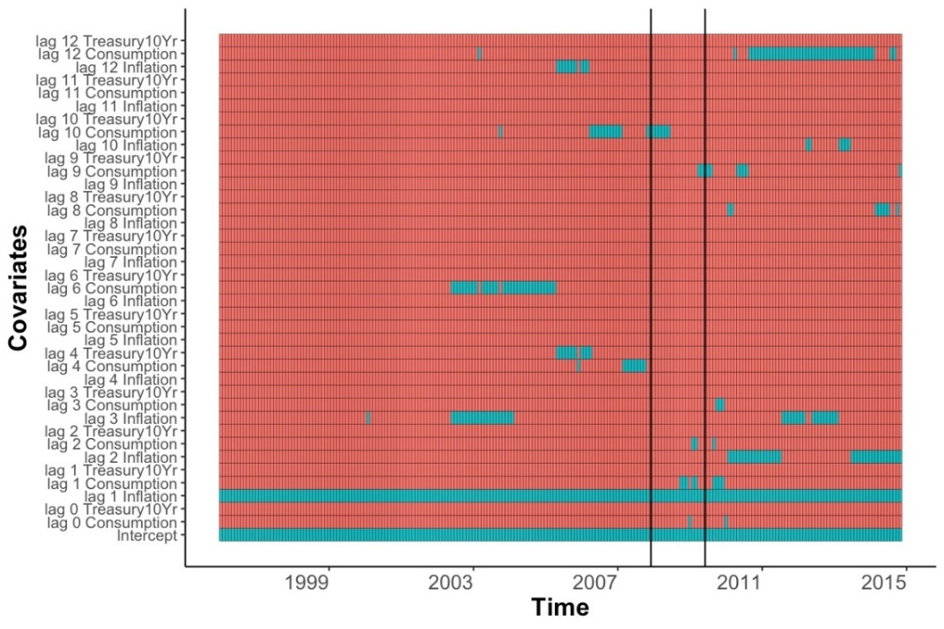
Macroeconomic forecasting: k=24 month horizon
AVS
Time trajectories:
Variable in “modal” INFLATION model?
IN or OUT
BMA
Lags

Slide 19
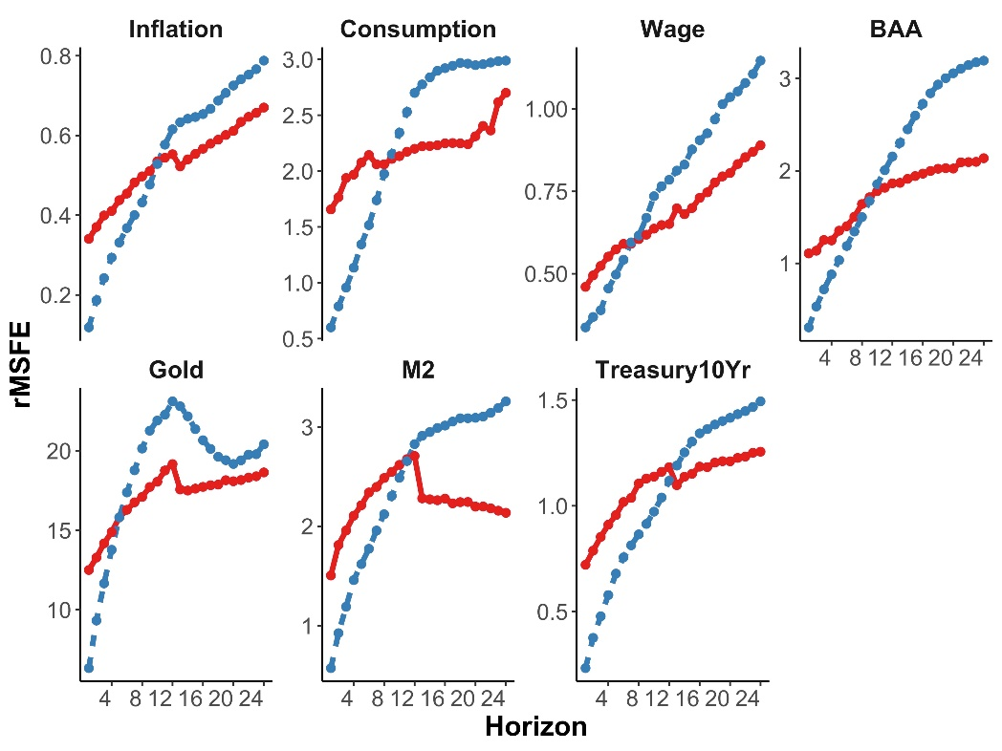
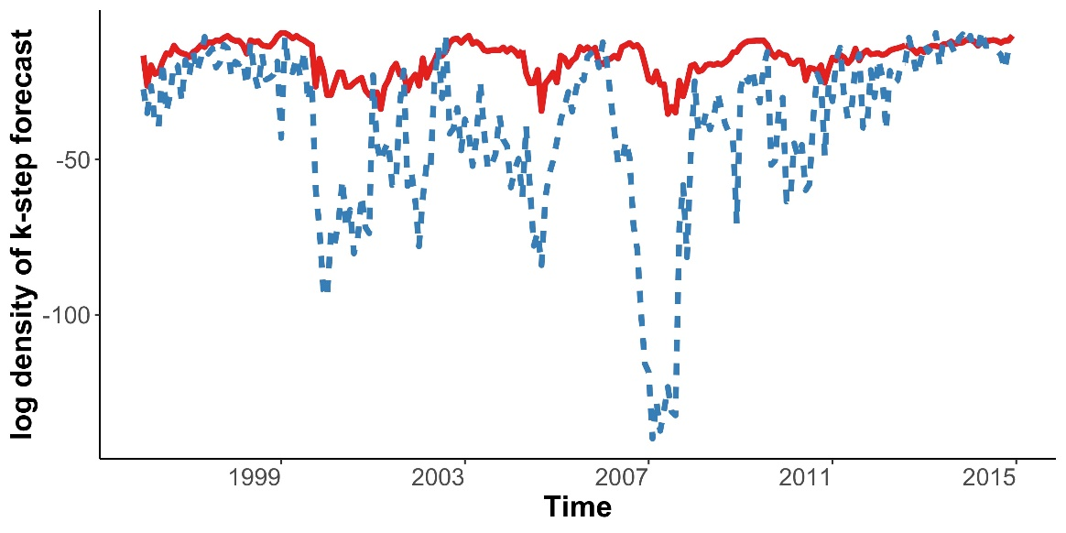
Global k=24 and k=1:24 forecasting assessment
BMA & AVS
Some forecast metrics
k=24
k=1:24

Slide 20
Key BPS examples (3): Outcome-dependent mixtures
Initial probabilities
Outcome-dependent weight functions
model-specific biases – “recalibrate”
regions/regimes of relative “expertise”
cross-model dependencies
estimate/optimise?
BPS foundation: - justifies outcome-dependent weights
- explicit framework for model-specific calibration
- explicitly allows model inter-dependencies
[ Kapetanios, Mitchell, Price & Fawcett ’15; Johnson & West ‘18]

Slide 21
Predictive “opinion” synthesis: But … other goals ?
: But … other goals ?
Decisions !?

Slide 22
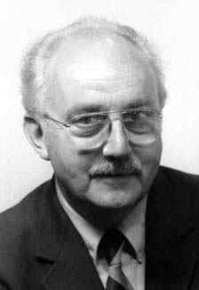

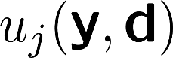


Another Bayesian with decision goals
Bayesian design:
- response surfaces
- computer model experimentation
- reinforcement learning, bandits
- control for policy decisions
George E.P. Box
1919 – 2013
Utility function:
Optimal decision:
Concept: predictive (&) decision synthesis:
- (also) weight/value models according to “good decisions” -

Slide 23
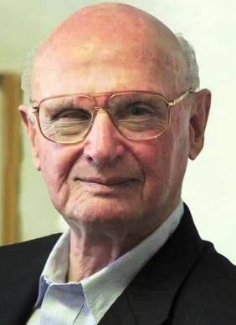







And another Bayesian with decision goals
Financial portfolio decisions:
- time series predictions
- decisions target return : risk trade-offs
Harry M. Markowitz
1927 –
Decision:
Portfolio return:
Utility function:
Optimal decision:
Realised portfolio return:
Bet on models with “good” portfolio decisions and outcomes

Slide 24
Predictive decision synthesis: Simplified portfolio example
Outcome *and* decision-dependent weight functions
Scores = Utilities
outcome & decision dependent
reward anticipated decision outcomes
multi-criteria decision analysis
Consistent/coherent with BPS-AVS updating on past realized
{ response & decision } outcomes

Slide 25



BPDS specification: Score (utility) weighting
?
Literature?
AVS
generalised Bayesian updating, …
tuning parameter?
context-specific “theory”?
BPDS: Natural new theory
“Relaxed” entropic tilting (RET)
Multi-attribute utility balancing
Anchor in initial mixture at

Slide 26








BPDS specification and RET: How and why it works
Initial mixture:
“small”
K-L closest to initial mixture
Least perturbed with (modest)
increased score target
BPDS distribution space: indexed by
“Small” perturbations: Modest tilting from initial mixture
Increased weights on models with “good” decisions, in expectation
Betting on potential increased payoffs as well as predictive accuracy

Slide 27





Predictive decision synthesis can improve decisions
Supra-Bayesian
... or bounded utility theory-based
&
[ Tallman & West ‘22]

Slide 28


“… problems depending on different opinions (are) interesting”
… problems depending on different predictions and decisions are more interesting

Slide 29













Some Bayesian synthesisers …
Ken McAlinn
Emily Tallman
Matt Johnson
Jouchi Nakajima
Isaac Lavine
Knut Are Aastveit
Michael Lindon
[ Bayesian Predictive Decision Synthesis, Emily Tallman & MW, 2022 ]

Slide 30
PR on related presentations @ ISBA 2022
Some posters
Tuesday: Danielle Cabel
Rishab Guha
Wednesday: Dawid Bernaciak
Matt Johnson
Thursday: Joseph Rilling
Oliver Robinson
Some talks
Monday 3:30pm
Herman van Dijk
Wednesday 1:30pm
Alice Kirichenko
Jack Jewson
Nicholas Syring
Chris Holmes
Friday 10:30am
Ken McAlinn
James Mitchell
Emily Tallman

Slide 31
And now … two distinguished predictivists
Sylvia Frühwirth-Schnatter
Herman K. van Dijk

